Slide 1

Introduction to JavaScript
Aris Markogiannakis
City University - Short Courses
CS3606 : JavaScript 2: Advanced Javascript for Websites and Web

Slide 2
Tutor
My name is Aris Markogiannakis
I have been a web developer for over 15 years now, working in a number of institutions and corporates
I am currently teaching Advanced JavaScript and .Net Core at City Short Courses
I have been teaching at Short courses for over 5 years now.

Slide 3
About you?
Tell me your name
Job Title
If you want where you work! And what you do at the moment?
And what you would like to learn from this course.
What is your knowledge in JavaScript

Slide 4
A very short history of JavaScript
1996 – Changed from LiveScript to JavaScript to attract Java Developers
1997 – ECMAScript 1 became the first version
2009 – EcmaScript 5 (ES5) was released with lots of new features
2015 – EcmaScript 2015 (ES2015) was released: the biggest update ever
2016 – EcmaScript 2016 (ES2016) was released with minor changes only.

Slide 5
What about today
ES5 is fully supported in all modern browsers
ES6/ES2015 only partial support in modern browsers, no support in older browsers. Can't use in production.
ES2016 Almost no support in modern browsers

Slide 6
Course Information
We will be using ES5 for the beginning of the course
We will switch to ES6 after the class 6
We will finish with two React classes
But firstly will go through the basics today and we will do a Revision in JavaScript before we get into the very advanced areas of the programming language

Slide 7
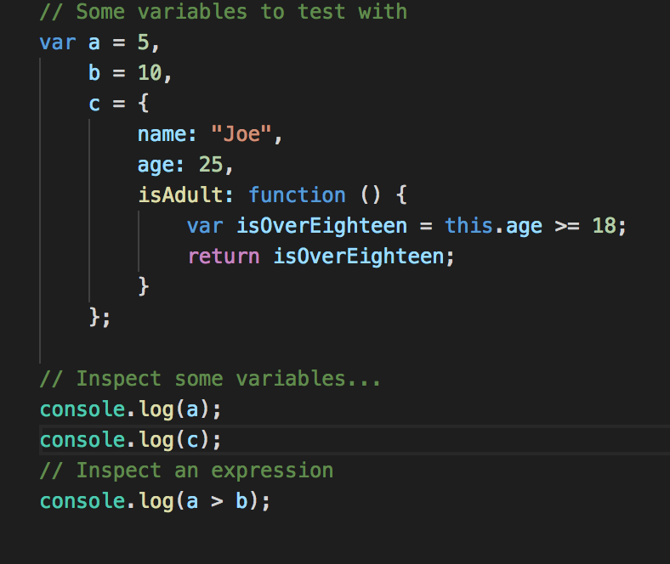
Debugging
What are the best ways of debugging our code
Using console host object, it is implemented by the browsers and it is not a part of JavaScript specification
We use the log method to inspect expressions
We then press F12 and then hit the console tab.

Slide 8
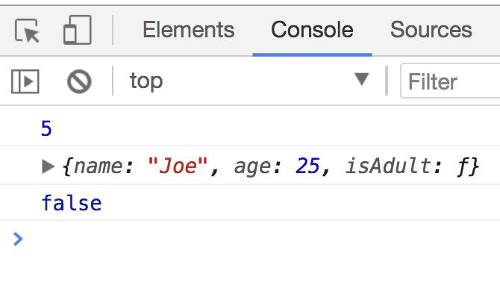
Debugging

Slide 9
Types
Which types do you know in JavaScript
string
number
boolean
null and undefined
object
symbol (new to ES6)

Slide 10
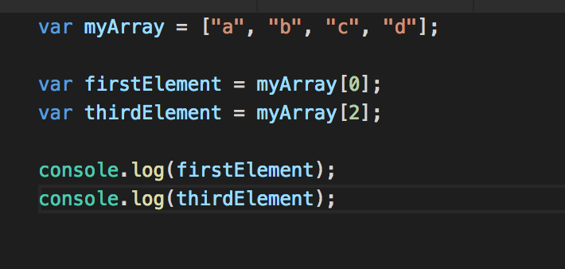
Arrays
Remember… Arrays are collections/lists of things
The values we store in arrays can be anything:
Strings, Integers, Booleans, Objects, other arrays
The 1st element’s index is 0
The last element’s index is the length of the array - 1
Notes:
Imagine that we have 3 variables that have the word name, but we want now to put all three values in a single variable
var names= [];
var years = new Array(element1, element2, element3);
How do we read those elements from the array?
How do we change the value in an array?
We can access the array by the index myarray[0] = 1;

Slide 11
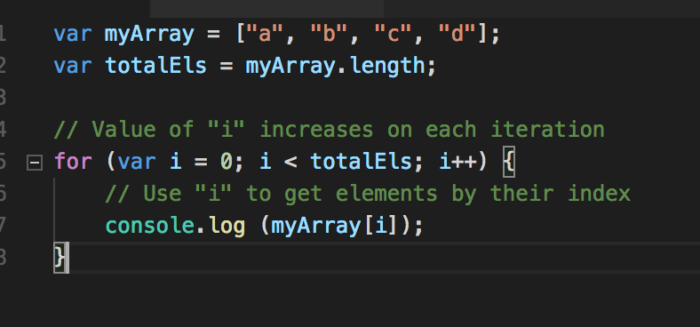
Iterating through an Array
We can iterate through the Array using the for loop
We will extend more on Arrays next week.

Slide 12
Exercise 1
Now it is time to do your exercise 1, please refer to moodle and download the Lesson 1- Exercises

Slide 13
Object
Refers to a compound value when you can set properties that hold their own values of any type.
We use object literals and instead of square brackets we use curly brackets.
var objExample= {
a: "Hello world",
b: 42,
c: true
}
Or
var objExample = new Object(
Notes:
More advanced topic
On the previous slide we spoke about Arrays and also how do we access an element from an array, to access it we had to use an index, but we can to access by a name can we?
Object we have key/value pairs
We use object literals

Slide 14
Objects
How do we read/write (data mutation) an object?
Using the dot notation – objExample.a
objExample.a = 25; or objExample[a] = 25; works the same as arrays!
Is there another way to declare an object?
var objExample = new Object();
objExample.name = “Smith”;
Can an object have functions?
Yes it can!

Slide 15
typeof
var a;
typeof a; // undefined
a = "hello world"
typeof a; // string
a= 42;
typeof a; // number
We can check the type of a variable by using the typeof method.

Slide 16
Exercises 2
Lets do the same with using objects if time allows..

Slide 17
DOM
JavaScript rarely works alone
When a web page is loaded by the browser, the browser builds a DOM for the page
DOM: Document Object Model
A programmatic representation of the web page, as a tree structure
Each element of the HTML page becomes a node in the tree
Element: tags, comments, text
We access the DOM programmatically via the document object variable:
var pTitle = document.title
var pURL = document.URL
var pBody = document.body;
Var pLinks = document.links;

Slide 18
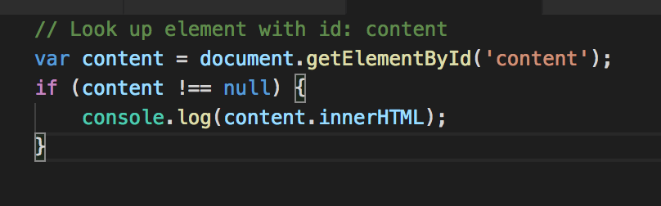
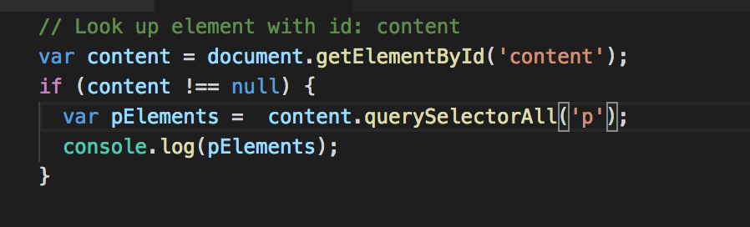
Elements
Each tag is represented by an Element object and properties that allows us to manipulate the element via the DOM!
How do we access an element?
If the element has an id (has to be unique) we can use
document.getElementById(‘container’)
Using the querySelectorAll method to get elements either by their CSS class element or their tag name.
Document.querySelectorAll(’p’);
Document.querySelectorAll(‘.highlight’);

Slide 19
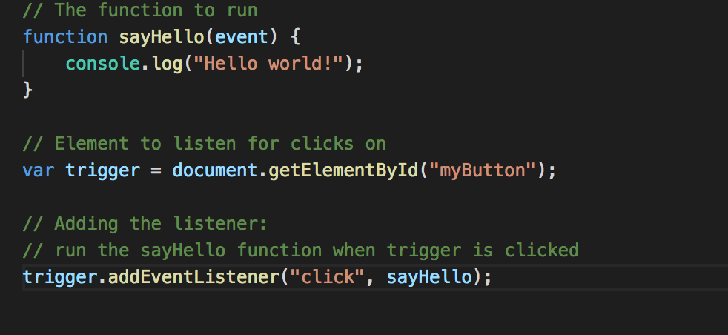
Events
JavaScript programming is all about responding to events that occur in the browser.
Events: click, mouseover, keyup, load. etc. To run code in response to browser events, use the addEventListener method of the Element object el.addEventListener(eventName, functionToCall);

Slide 20
Insert content to the page
What if we wanted to add our own text or an element to the page, can we?
insertAdjacentHTML() parses the specified text as HTML or XML and inserts the resulting nodes into the DOM tree at a specified position.
It takes two arguments
Position

Slide 21
Exercise 3
Now it is time to do the Exercise 3

